Slide 1
Magnetic Separation of Uranium and Plutonium
James Voss
Moscow, October 17, 2012

Slide 2
Contents
Problem Statement
Paramagnetism
First Demonstration – Nevada Test Site
Second Demonstration – Aldermaston
Final Observations

Slide 3
Problem Statement
The problem addressed was to decontaminate soils containing plutonium oxide or elemental plutonium that is < 75 μ in size.
Plutonium that is < 75 μ is a problem because gravity methods are not effective
This situation exists on many US Federal government sites as well as sites in the UK and elsewhere.

Slide 4
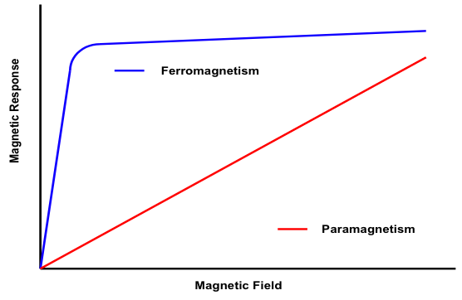
Paramagnetism - 1

Slide 5
Magnetic Susceptibility Properties
Compount/Element | Susceptibility Constant (x 10⁶)
FeO | 7178
UO2 | 1204
Cr2O3 | 844
NiO | 740
Am | 707
Pu | 636
PuO2 | 384
CuO | 242
Th | 41
UO3 | 41
CrO3 | 14

Slide 6
Paramagnetism - 2
Flow of slurry with paramagnetic material

Slide 7
Paramagnetism - 3

Slide 8
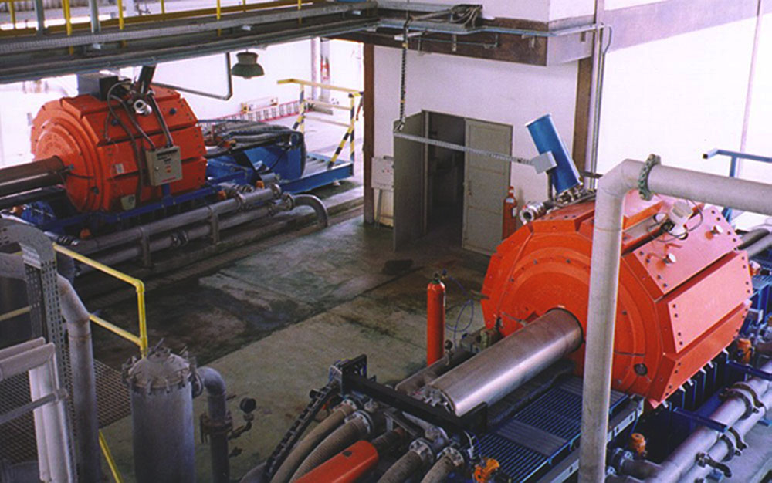
Twin Magnetic Separators

Slide 9
First Demonstration
Nevada Test Site

Slide 10
Problem Statement - Nevada
Metallurgical development activities at the NTS has resulted in significant areas being contaminated with plutonium oxide. The majority of the plutonium is smaller than 10 μ in size, and hence is mobile and respireable.
The objective was to develop and demonstrate a technology that could cost-effectively decontaminate the surface soils.

Slide 11
Basic Flowsheet - Nevada
Collect NTS Soils
75 μ Size Split
Magnetic Separation on Small Fraction
Large Fraction
Pu Concentrate
Decontaminated Soils

Slide 12
Results - Nevada
In the < 75 μ fraction, 80% of the Pu was captured in the magnetic fraction
50% of the total mass of the < 75 μ fraction was also captured in the magnetic fraction
The problem was that the Nevada soil samples were dominated by Magnetite which is highly magnetic
There was a 60% increase in Pu concentration but only a 50% mass reduction in the magnetic fraction

Slide 13
Solution to Magnetite Problem – Nevada – Second Pass through Separator at Lower Field Strength
Pu Concentrate
Magnetic Separation in Lower Magnetic Field
Magnetite Fraction
Pu Fraction

Slide 14
Nevada Test Site Results
The work demonstrated the ability to concentrate plutonium
The work revealed the challenge – knowing the properties of the feed material
The Government did not select this approach and the project ended

Slide 15
Second Demonstration
Aldermaston, UK

Slide 16
Problem Statement - Aldermaston
Approximately 50,000 cubic meters of soils have been collected and are being stored. The dominant radioactive constituent is plutonium. The plutonium is very small in particle size and its chemical form depends upon the origin of the soils.
The objective of the work was to develop a technology that can decontaminate > 90% of the soils, reducing it to less than 0.4 Bq/g Pu.

Slide 17
Basic Flowsheet - Aldermaston
Aldermaston
Soil Sample
75 μ Size Split
Magnetic Separation on Small Fraction
Large Fraction
Pu Concentrate
Decontaminated Soils

Slide 18
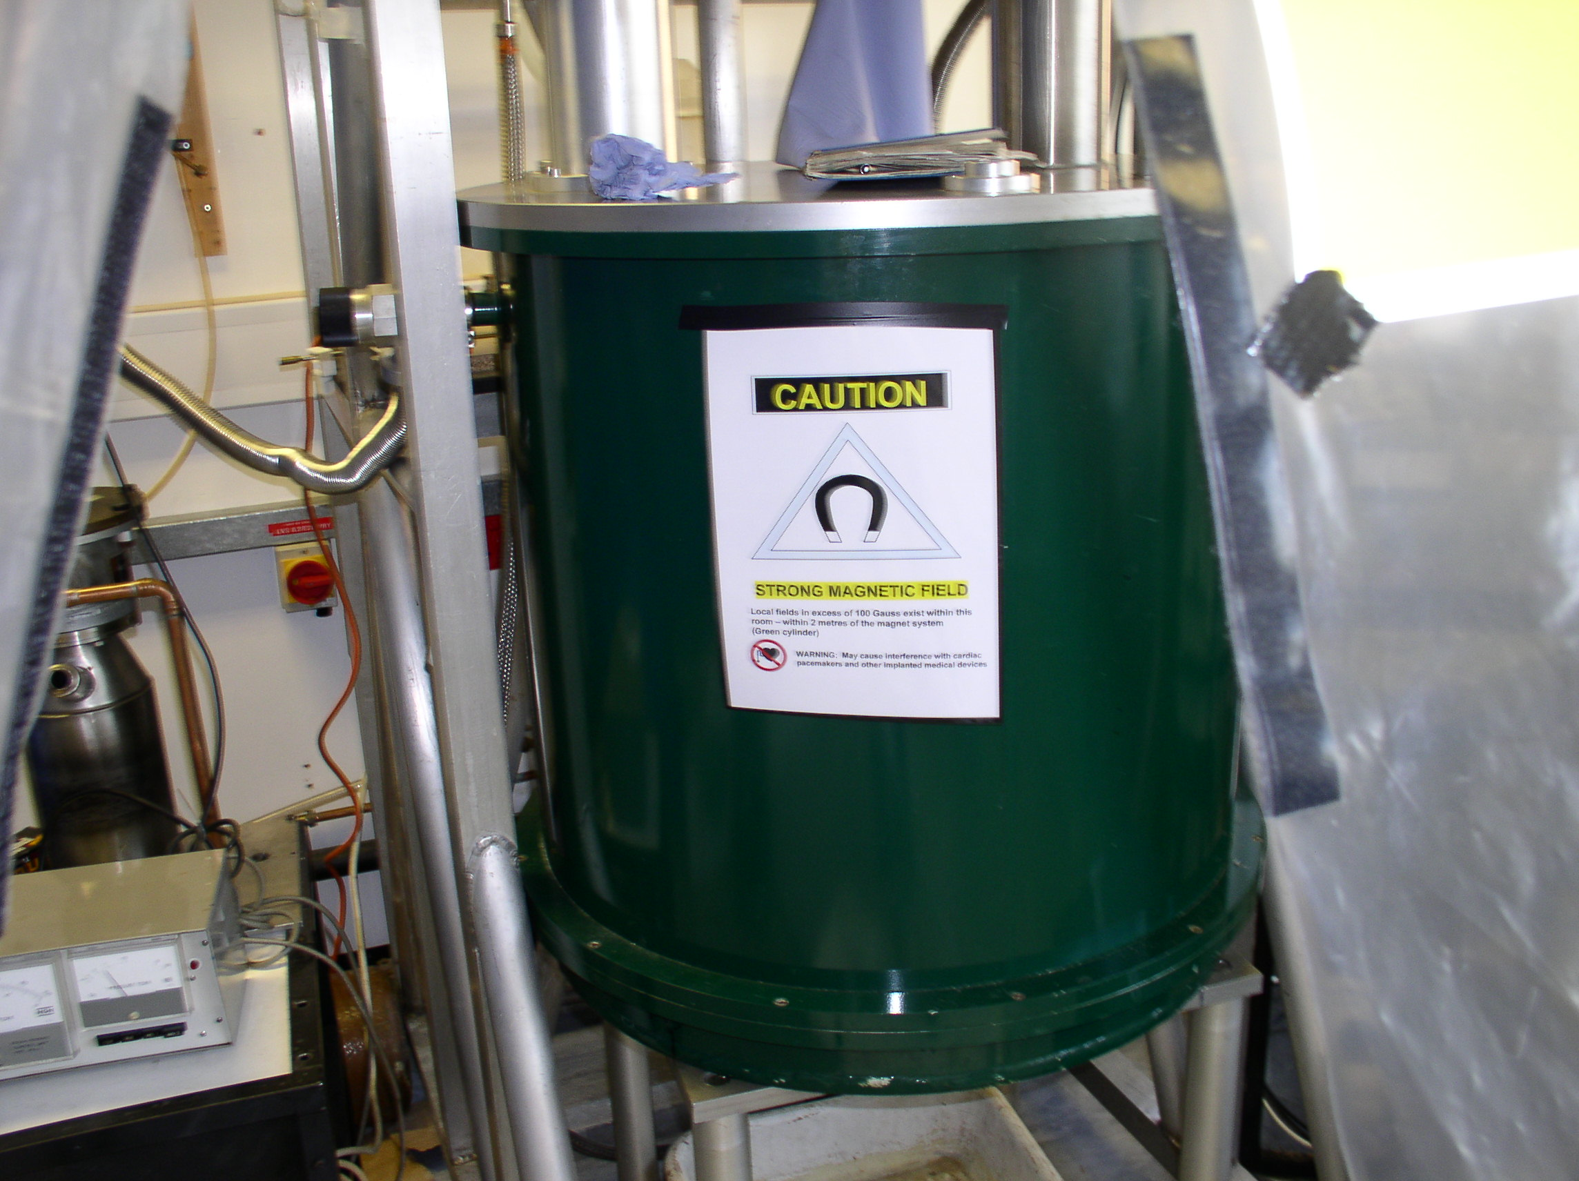
Lab Scale 5 Tesla Magnetic Separator

Slide 19
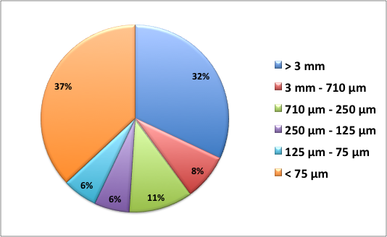
Characteristics of Aldermaston Sample – Size Distribution

Slide 20
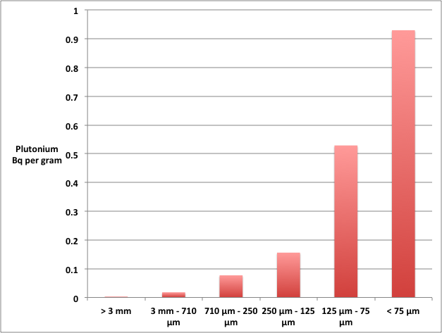
Plutonium Distribution in One Sample – After Washing, per dry gram

Slide 21
Typical Results –
96% Below 0.4 Bq/g
Soil Sample
1000 g
0.62 Bq/g
620 Bq
>75 μ Fraction
630 g
0.1 Bq/g
65 Bq
Non Magnetic Fraction
329 g
0.25 Bq/g
83 Bq
Magnetic Fraction
41 g
11.5 Bq/g
472 Bq
<75 μ Fraction
370 g
1.5 Bq/g
555 Bq

Slide 22
Additional Experimentation - Aldermaston
Initial work was on soils containing uranium – results were slightly better than for plutonium
Chemical pretreatment to liberate Pu from soils – selected reagents ineffective except citric acid
Thermal pretreatment in order to oxidize Pu – ineffective
Ultrasonic vibration to liberate PuO2 particles -- ineffective

Slide 23
Limitations
Some plutonium compounds are not paramagnetic
Feed material must be smaller than ~ 75μ; otherwise the mass of the particles is too great to be influenced by the magnetic field

Slide 24
Additional Limitations
One set of samples came from a swamp
The material contained a significant amount of vegetation
It is believed that some portion of the plutonium had formed organic compounds that are not paramagnetic
The techniques tried were not successful in decontaminating this material

Slide 25
Final Observations
Paramagnetic separation has been demonstrated to be effective in cleaning soils of uranium and plutonium
The approach should be considered, along with many other techniques, as a viable option for waste management and site remediation purposes
The solution is useful in any situation where a paramagnetic form of plutonium and uranium needs to be separated from a liquid stream.

