Slide 1

Sound Nuclear Back-End Strategies for the Safe Management of Used Nuclear Fuel
VI International Exhibition and Conference – AtomEco2012
16-17 October 2012, Radisson Slavyanskaya Hotel
Moscow, Russia
Sylvain Saint-Pierre
Vice-President Marketing, Energy & Nuclear
SENES Consultants Limited
ssaintpierre@senesuk.com

Slide 2
Outline
Sound strategies for the nuclear back-end
The flow of used nuclear fuel (UNF) and related safety concerns
Conclusions

Slide 3
Sound Strategies for Nuclear Back-End
Sound strategies are important for the long-term (LT) sustainability of nuclear power generation
Enacted through comprehensive national regulations and programmes
An advantage is that they “entrench” the course of deployment over the LT
A downside is a temptation to skip (by indecision or inaction) important nearer term progress

Slide 4
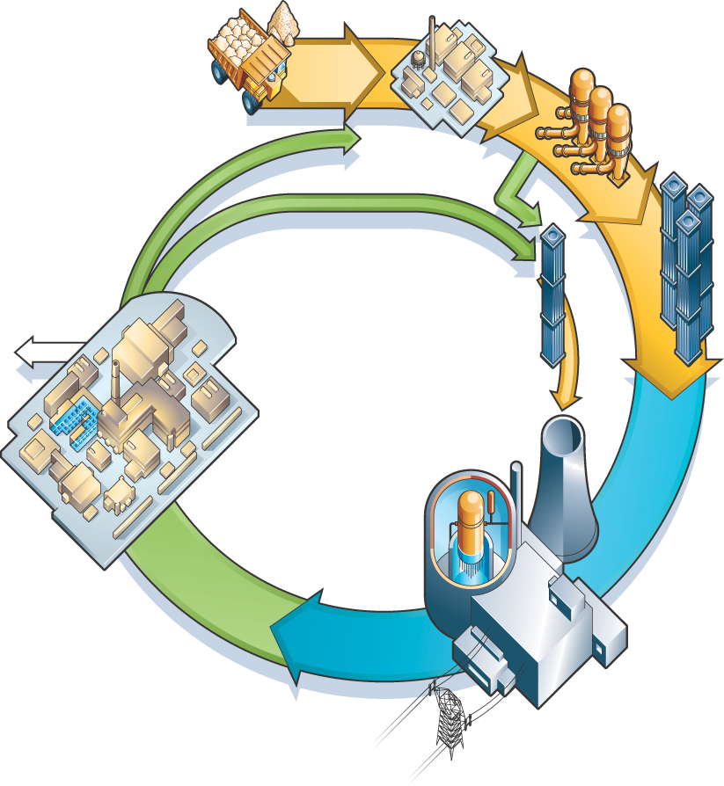
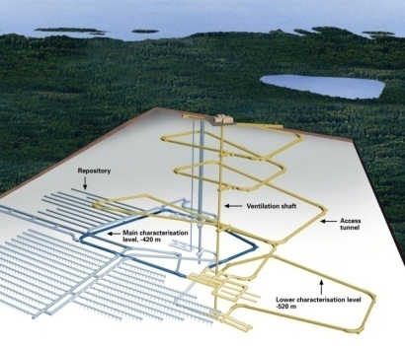
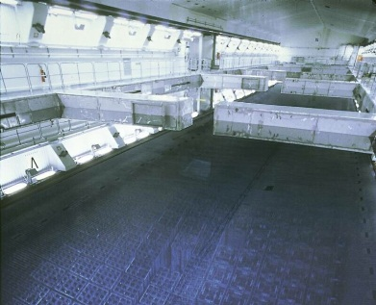
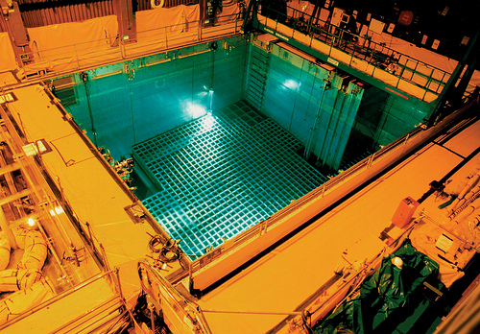
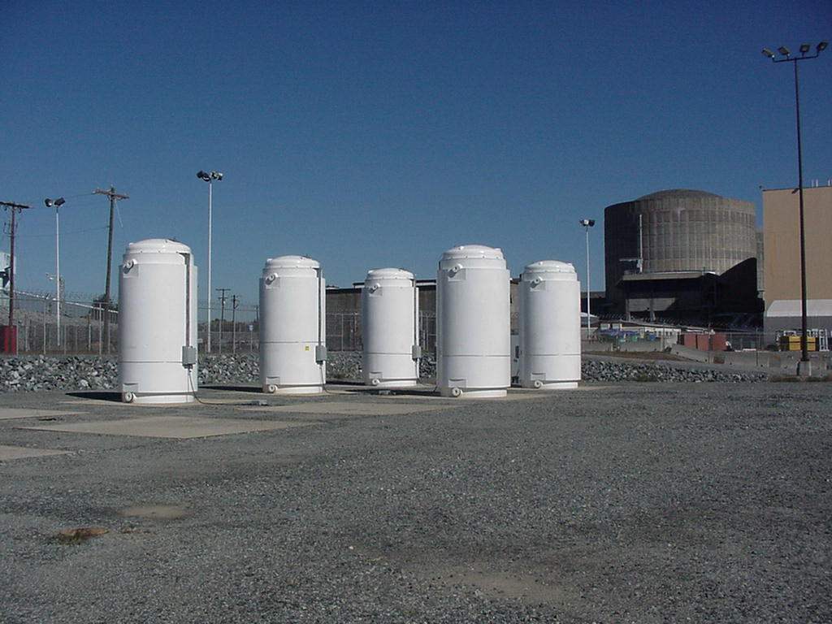
Sound Strategies for Nuclear Back-End
UNF flow
3a. Disposal
3b. Reprocessing & Recycling
1. Nuclear Power Plant (NPP)
2. Interim Storage (dry or wet)
1a. NPP (UNF storage pools)
20 t or 40 m³ UNF
20 t U fuel

Slide 5
NPP UNF Storage Pools: UNF Flow
Amount + volume of “fresh” UNF generated each year at an NPP are small
Over the years, UNF volume in storage pools gradually accumulates
After a few years or more, slightly “aged” UNF is ready to be sent for Interim Storage (IS)
Options for optimization of UNF storage in NPP pools exist: e.g. racking with higher density

Slide 6
NPP UNF Storage Pools: Safety
Safely storing UNF is straightforward …but cannot afford to lose water + make-up water
Hopefully, this very important lesson has been learned by all
If too much water is lost, fuel quickly heats-up, high radiation, lost of shielding => Gy/h !!!
Time to act is short
Can jeopardize emergency response + ultimately lead to lose the site!

Slide 7
NPP UNF Storage Pools: Safety
A natural human tendency
Underestimate (low probability) risk of high consequences
Overestimate (high probability) risk of low consequences
A change of paradigm
Probability risk assessment (PSA) remains useful
But preparation for severe accidents of longer duration is needed
Remember the Greek goddess “Fortuna”: Both good luck and bad luck repeatedly occur

Slide 8
NPP UNF Storage Pools: Safety
Further improve Prevention… + expand Mitigation is the name of the game
Examples of upgraded measures for NPPs associated with UNF storage pools
Back-up diesel generators (water proof) + pumps
Back-up water supply + plug-in for external water supply
Improved monitoring instrumentation:
  Water temperature and level in pools
Mobile intervention equipment

Slide 9
NPP UNF Storage Pools: Flow + Safety
Enabling the flow of slightly “aged” UNF from NPP storage pools to Interim Storage is important, including for safety
Indecision or inaction on the over accumulation of UNF in NPP pools should not be an option

Slide 10
Interim Storage: UNF Flow
As viewed earlier….After a few years or more, slightly “aged” UNF from NPP storage pools is ready for Interim Storage (IS)
Planning and implementation for this transfer to IS over the mid-term (e.g. 5-20 years) is important

Slide 11
Interim Storage: UNF Flow
Next after Interim Storage (IS), “older” UNF is ready to be sent for reprocessing/recycling, direct disposal, or a combination of both
Planning and implementation for this transfer is important:
Over the mid-term (e.g.10-20 years) to reprocessing/recycling
Over the longer-term (e.g. 20-50+ years) to direct disposal

Slide 12
Interim Storage : Safety
Both dry or wet storage are safe
Bear in mind though the lessons learned on UNF in NPP storage pools
Heat load is less significant for “aged” UNF and the time to act is greater (than for “fresh” UNF) in case of issues

Slide 13
Interim Storage: Flow + Safety
Enabling the flow of “older” UNF from Interim Storage to reprocessing & recycling, direct disposal or a combination of both is important, including for safety
Indecision or inaction on the over accumulation of UNF in Interim Storage should not be an option

Slide 14
Back-End Options:
Reprocessing & Recycling (R&R) + Direct Disposal
Readiness for timely reception of “older” UNF from interim storage to R&R or direct disposal is important
A combination of both back-end options may offer increased flexibility
Both back-end options (R&R and direct disposal) are safe

Slide 15
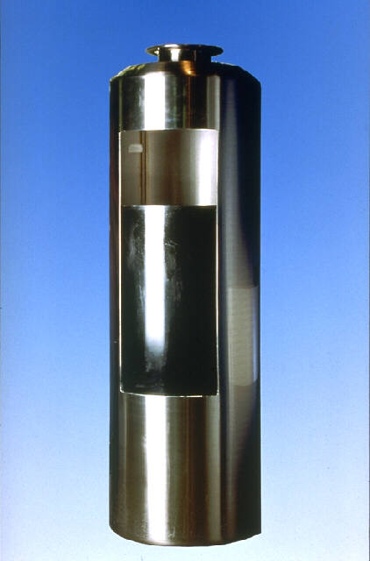
Reprocessing & Recycling: UNF->HLW
Some countries* reprocess UNF, thereby converting it into smaller volumes of HLW and ILW
… [HLW canister for storage/disposal]
*: e.g. France, Russia, etc.
For disposal, LT containment relies on the glass matrix of vitrified HLW

Slide 16
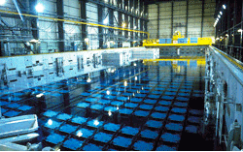
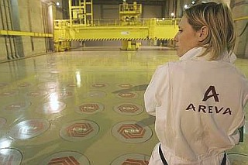

Reprocessing & Recycling: UNF->HLW
Example: Storage of UNF and HLW at La Hague reprocessing/recycling plant

Slide 17

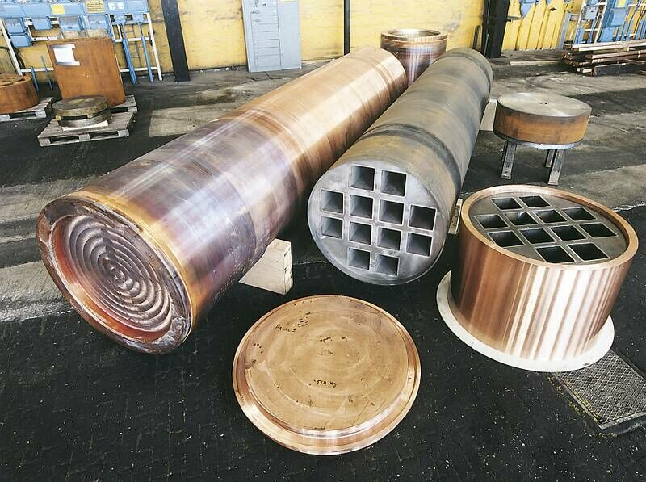
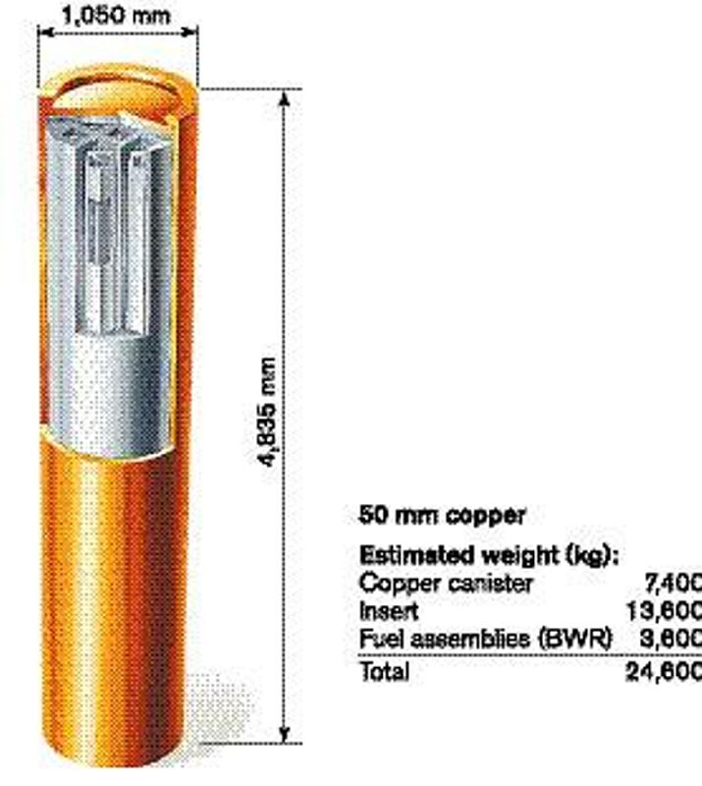
UNF Direct Disposal
Some countries* deal with UNF as waste…
[UNF canister for storage/disposal]
*: e.g. Sweden, Finland, etc.
LT containment relies on container

Slide 18
Disposal Concept
Achieved through a suitable geological formation, located at several hundreds of metres underground that is highly impermeable
It limits the LT risk of radioactivity releases via the transport of radionuclides by groundwater
Containment is provided by a suitable geology compensated by suitable engineered measures

Slide 19
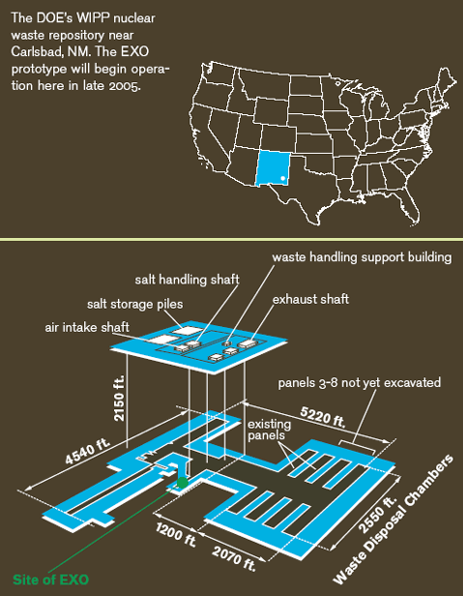


Disposal Concept: Examples
Sweden
Finland
USA - WIPP

Slide 20
Disposal Concept
Containment is overwhelmingly important. Protection? – can become surrealist (e.g.LT doses)
If containment fails, re-establishing containment comes first (not really protection)
Mining deposits are repeated proofs of materials concentrated and contained in a same geological location since the Earth creation
Disposal is combining the mineral world and the industrial world to offer a sound practical solution

Slide 21
Reprocessing & Recycling + Direct Disposal
Enabling the flow of “older” UNF from Interim Storage to the back-end options is important, including for safety
Indecision or inaction on the over accumulation of UNF in Interim Storage should not be an option

Slide 22
Conclusions
Sound back-end strategies need to keep sight of the necessary flow of UNF all along the strategies’ elements
Enabling this flow is an important part of safety
Steady progress on the gradual implementation of strategies’ elements is important
Indecision or inaction should not be an option
Thank you for your attention
Sylvain SAINT-PIERRE, saintpierre@senesuk.com

