Slide 1
Something Old – Something New:
The Merits and Remaining Tasks for the G-8 Global Partnership
Lars van Dassen
Head,
Secretariat for International Cooperation and Development
Swedish Radiation Safety Authority, SSM

Slide 2

The G-8 Global Partnership at 10: when looking ahead – we have to look back, and when looking back we have to consider the future to get the right frame for interpretation.

Slide 3
Looking back:
The GP was established in 2002 by the G-8 in response to a new level of global terrorist threats
Focussed on Russia and later Russia and Ukraine
Has achieved tremendous progress as concerns submarine dismantlement, abolition of chemical weapons, control of nuclear and radioactive materials

Slide 4
Looking Ahead:
The GP has in 2012 been extended for ten more
years till 2022
It now has 24 members – and will have even more
With activiites in all regions of the world
. . . And in all WMD areas
Yet, in Russia and Ukraine many things remain
to be done in the (”legacy”) radiological/nuclear field

Slide 5
Mixing the Old Agenda and New Times
- Is necessary for its own sake to remedy the Cold War
legacy issues for which we all have a shared resposibility
Is necessary in order to create confidence is the GP
as an institution and problem-solver – everywhere
The GP work by partners in Russia and Ukraine is a
well of information and inspiration for those who start
working in other regions and with other issues

Slide 6
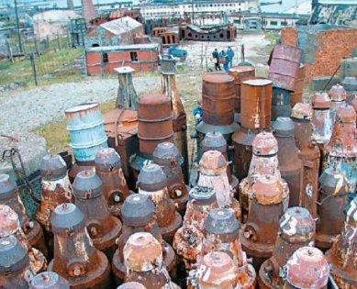

Working in and with Russia: What will it take in the future? (1)
"инвентаризация"
Russian authorities have to state where the issues are and what needs to be done

Slide 7

Working in and with Russia: What will it take in the future? (2)
- Russian authorities need to give priority to international projects and give them an easier trip through Russian agencies and procedures.
- A centralized GP-implementation office that can cut red tape and push issues needs to be considered

Slide 8

The GP 2012 - 2022: A Choice of Two Spirals
Downward: Unclear definitions of remaining legacy issues as well as struggles with project implementation will reduce the ability of governments to ensure funding and continued engagement
Upward: Russian authorities state the issues where cooperation is needed and facilitates project implementation.
-This will attract partners to work with Russia and inspire work in other regions and on other issues

Slide 9
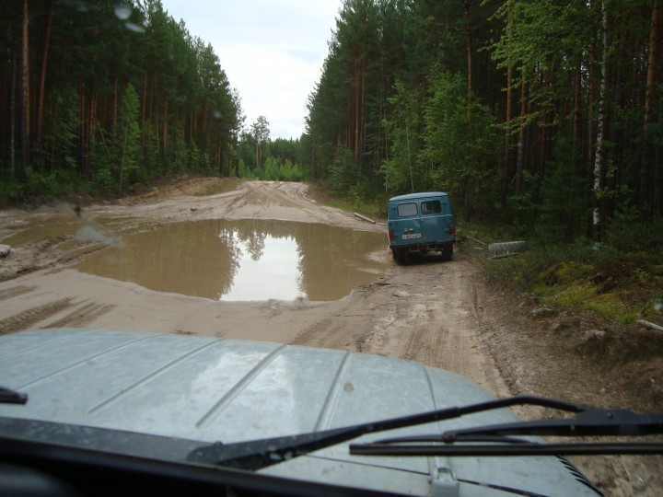
A final word: It is possible to travel far and well - where people have built a road . . . .

